Slide 1

18ECE340T- MACHINE PERCEPTION WITH COGNITION
UNIT-3
Filters in Image Processing

Slide 2
Filters
Applying filters to the image is an another way to modify image. And the difference compare to point operation is the filter use more than one pixel to generate a new pixel value. For example, smoothing filter which replace a pixel value by average of its neighboring pixel value.
Filters can divided in 2 types,
linear filter and non-linear filter.

Slide 3
Filter - Types
Filter
Linear Filter
Non-Linear Filter
Smoothing Filter
Different Filter
Maximum and Minimum Filter
Box Filter
Laplace or Mexican Hat Filter
Median Filter
Gaussian Filter
Weight Median Filter

Slide 4
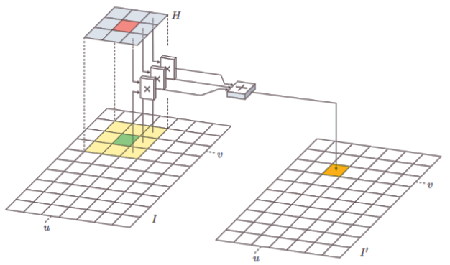
Linear Filter
Linear filter is a filter which operate the pixel value in the support region in linear manner (i.e., as weighted summation).
The support region is specified by the ‘filter matrix’ and be represent as H(i,j). The size of H is call ‘filter region’ and filter matrix has its own coordinate system, i is column index and j is row index.
The center of it is the origin location and it is called the ‘hot spot’.

Slide 5
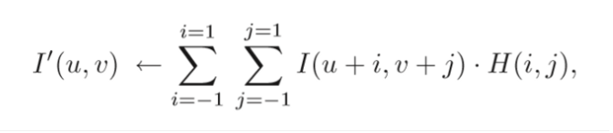
Linear Filter
Steps to apply the filter to the image:
Move the filter matrix over the image I and H(0,0) must go along with the current image position (u,v)
Multiply each filter coefficient H(i,j) with the corresponding image element I(u+i,v+j)
Average all result from the previous step and it is the result for the current location I(u,v)

Slide 6
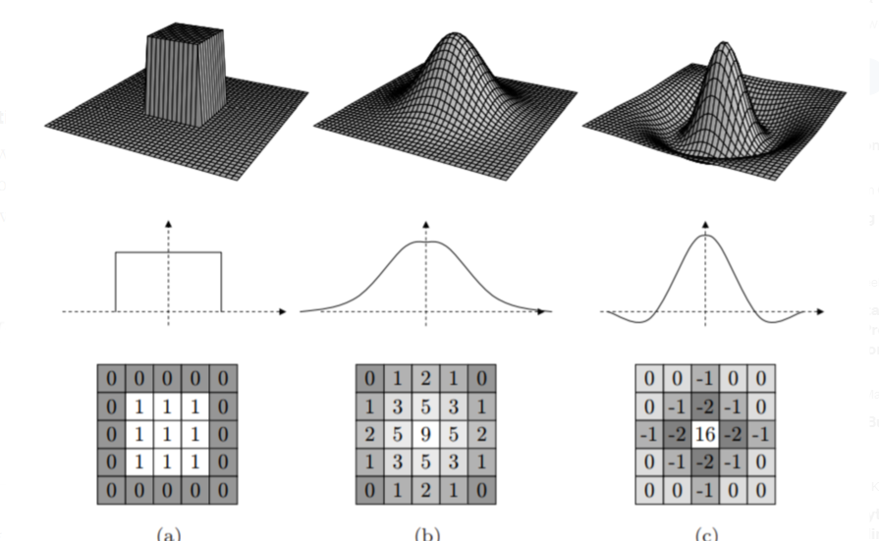
Linear Filter - Types
(1) Smoothing Filter (has only positive integer.)
Box filter. All members of this filter are the same.
Gaussian filter. The weight of filter member depend on the location of the member. The center of the filter receive the maximum weigh and it decreases with distance from the center.
(2)Different Filter
Laplace or Mexican hat filter. Some members of this filter are negative filter and it can calculate by summation of positive member and negative member.

Slide 7
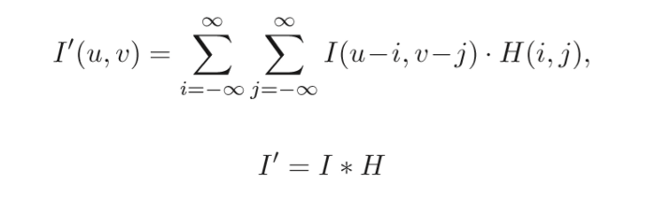
Linear Filter - Properties
Linear Convolution
The convolution matrix H can be called kernel.
Properties of Linear Convolution
Commutativity
Linearity
Associativity
Seperability: the kernel H can be represented as the convolution of multiple kernels and can separated in a pair dimensional kernel x and y.

Slide 8
Linear Filter - Properties
Linear Convolution
The convolution matrix H can be called kernel.
Properties of Linear Convolution
Commutativity
Linearity
Associativity
Seperability: the kernel H can be represented as the convolution of multiple kernels and can separated in a pair dimensional kernel x and y.

Slide 9
Non- Linear Filter
Non-Linear Filters
Noise removing with smoothing filter (a linear filter) provide the result in burred of the image structure, line and edge. Non-Linear Filters were used to solve this problem and it works in non-linear manner.

Slide 10
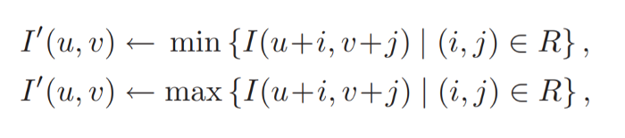
Non- Linear Filter - Types
Minimum and Maximum Filters:
The minimum and maximum value in the moving region R of the original image is the result of the minimum and maximum filter respectively.

Slide 11
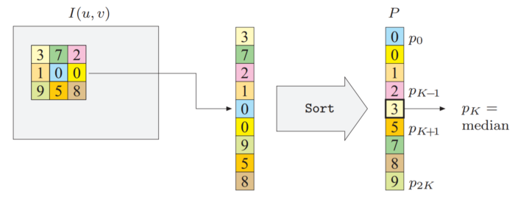
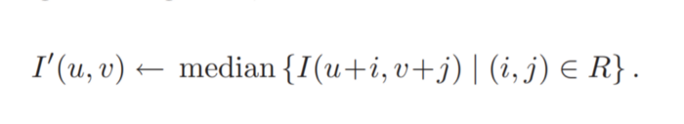
Non- Linear Filter - Types
Median Filters:
The median of all value in moving region R is the result of the median filter.
This filter is used to remove salt and pepper noise in the image.

Slide 12
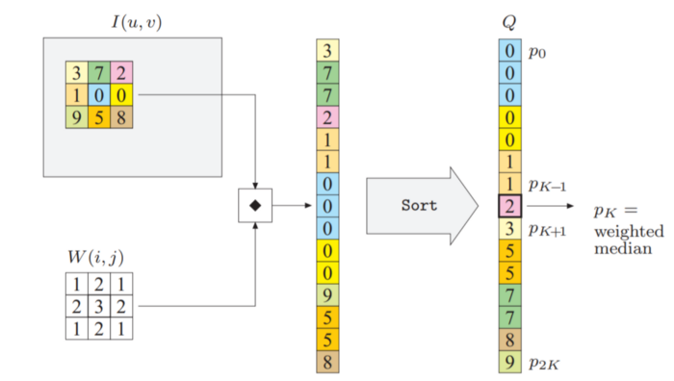
Non- Linear Filter - Types
Weight Median Filters:
Similar to the median filter.
The word “Weight” means extension of each member in the kernel according to weight matrix W.
The position of the filter member near hot spot will obtain the higher weight than others.

Slide 13
Filtering in the spatial domain (Spatial Filtering)
Filtering refers to image operators that change the gray value at any pixel (x, y) depending on the pixel values in a square neighborhood centered at (x, y) using a fixed integer matrix of the same size.
A pixel's neighborhood is some set of pixels, defined by their locations relative to that pixel.
The integer matrix is called a filter, mask, kernel or a window.
The values in the filter sub image are known as coefficients
Filtering operations that are directly performed on the pixels of an image is called spatial filtering

Slide 14
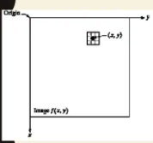
Filtering in the spatial domain (Spatial Filtering)
Spatial domain refers to the image plane itself .
Direct manipulation of pixels in an image
g(x, y) =T[f(x, y)]
where g(x, y) is the input image,
f(x, y) is the processed image and
T is an operator on f defined over some neighborhood of f(x, y)
Frequency domain is based on modifying the Fourier transform of the image

Slide 15
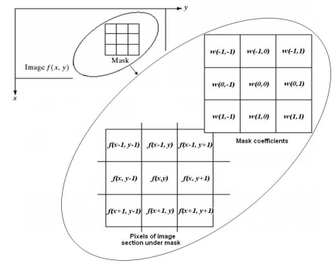
Basics of Spatial Filtering

Slide 16
Basics of Spatial Filtering
The process consists of moving the filter mask from point to point in an image
At each point (x, y) the response of the filter at that point is calculated using a predefined relationship.
The size of mask must be odd [i.e 3 x 3, 5 x 5, etc.] to ensure it has a center.
The smallest meaningful size is 3 x 3.

Slide 17
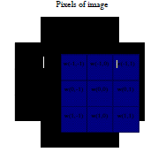


Linear Spatial Filtering (Convolution)
The result is the sum of products of the mask coefficients with the corresponding pixels directly under the mask

Slide 18

Linear Filtering
The coefficient w(0,0) coincides with image value f(x, y), indicating that the mask is centered at (x, y) when the computation of sum of products takes place.
For a mask of size m x n, we assume that m = 2a+1 and n=2b+1, where a and b are nonnegative integer.
Then m and n are odd.
In general, linear filtering of an image f of size M x N with a filter mask of size m x n is given by the expression:

Slide 19
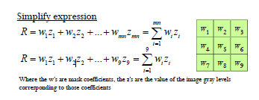
Linear Filtering
The process of linear filtering similar to a frequency domain
concept called “convolution”:

Slide 20
Nonlinear Spatial Filtering
The process consists of moving the filter mask from point to point in an image
The filtering operation is based conditionally on the values of the pixels in the neighborhood, and they do not explicitly use the coefficients in the sum of products manner.

Slide 21
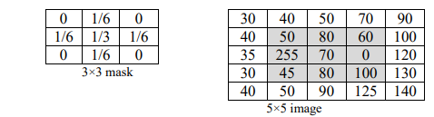
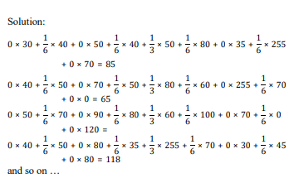

Use the following 3 x 3 mask to perform convolution process on the shade pixels in the 5 x 5 image below. Write the filtered image

Slide 22
Spatial Filters
Spatial filters can be classified as follows
Smoothing Spatial Filters (Low pass filters)
Averaging linear filters
Order-statistics nonlinear filters
Sharpening Spatial Filters

Slide 23
Smoothing Spatial Filters
Smoothing spatial filters are used for blurring and for noise reduction.
Blurring is used in pre-processing steps to
Remove small details from an image prior to (large) object extraction
Bridge small gaps in lines or curves
Noise reduction can be accomplished by blurring with a linear filter and also by nonlinear filtering

Slide 24
Averaging Spatial Filters
The response of the averaging filter is the average of the pixels contained in the neighborhood of the filter mask
The output of averaging filters is a smoothed image with reduced sharp transitions in gray levels.
Noise and edges consist of sharp transitions in gray level.
Hence smoothing filters are used for noise reduction though they have undesirable side effect that they blue edges.

Slide 25
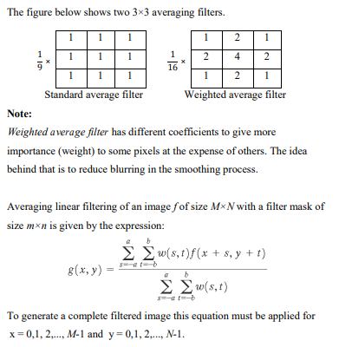
Averaging Spatial Filters

Slide 26
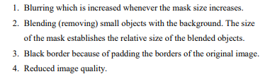
Averaging Spatial Filters
The effects of averaging filter are as follows

Slide 27
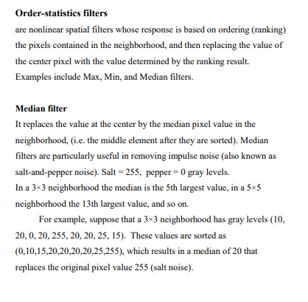
Order-statistics and median Filters

Slide 28

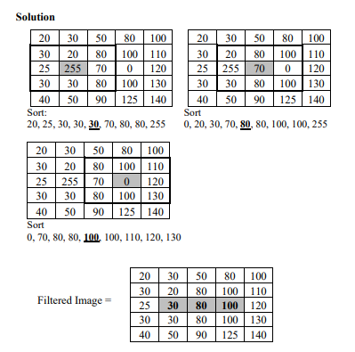
For the 5 x 5 image shown below, apply 3 x 3 median filter on the pixels and write the filtered image

Slide 29
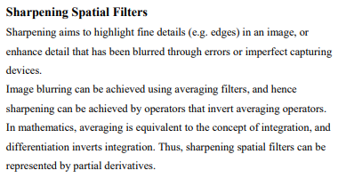
Sharpening Spatial Filters

Slide 30
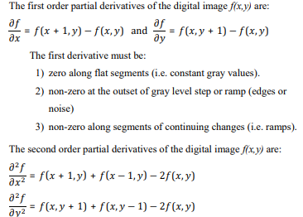
Partial derivative of Digital functions
The second derivative must be
Zero along flat segments
Nonzero at the outset and end of a gray level step or ramp
Zero along ramps
The first derivative detects thick edges while second derivative detects thin edges.
second derivative has much stronger response at gray level step than first derivative
Thus second derivative enhances fine details

Slide 31
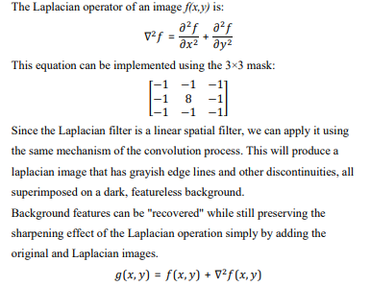
The Laplacian Filter

